Slide 1
Predicting High‑Traffic Recipes Practical EXAM for data scientists - Recipe Traffic Site
Presented by Neelanjan Goswami

Slide 2
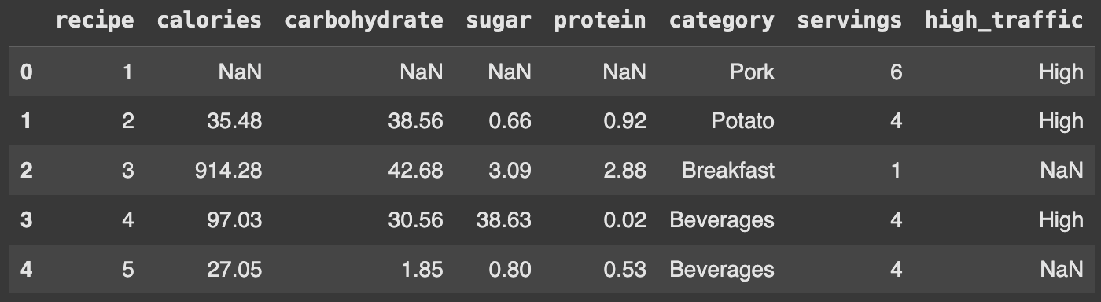
Overview of the Data
Notes:
Here’s our raw dataset: 947 unique recipes, each described by eight features—page path, category, servings, calories, carbohydrate, sugar, protein, and our target label high_traffic.
We see 10 distinct categories ranging from ‘Beverage’ to ‘Dessert.’
The high-traffic flag is unbalanced at roughly 60% High vs. 40% Low—important to note before modeling.
Numeric features vary widely: calories span from near zero up to several thousand, while macronutrients show heavy skew.
This slide establishes the scope: sub-1,000 recipes, a handful of categorical buckets, and a moderately imbalanced target we’ll need to address downstream.

Slide 3
Overview of the Data
Context: Tasty Bytes offers recipe search, meal‑plan subscriptions, and ingredient delivery. Displaying popular recipes drives subscriptions and revenue.
Goal: Automate identification of high‑traffic recipes with ≥ 80% accuracy.
Dataset: 947 recipes × 8 features (page path, category, servings, calories, carbohydrate, sugar, protein, high_traffic)
Key Metrics:
Records: 947 recipes
Categories: 10 unique (e.g. Beverage, Main Course)
High traffic ratio: ~60% High vs 40% Low
Notes:
Here’s our raw dataset: 947 unique recipes, each described by eight features—page path, category, servings, calories, carbohydrate, sugar, protein, and our target label high_traffic.
We see 10 distinct categories ranging from ‘Beverage’ to ‘Dessert.’
The high-traffic flag is unbalanced at roughly 60% High vs. 40% Low—important to note before modeling.
Numeric features vary widely: calories span from near zero up to several thousand, while macronutrients show heavy skew.
This slide establishes the scope: sub-1,000 recipes, a handful of categorical buckets, and a moderately imbalanced target we’ll need to address downstream.”

Slide 4
Cleaning & Validation
Steps:
Mapped “Chicken Breast” → “Chicken”
Parsed servings to numeric; removed “as a snack” suffix
Imputed missing nutrition by category‑serving averages
Filled missing high_traffic as “Low”
Verified no duplicate recipes; assumed self‑consistency
Notes:
Our first step was ensuring data quality:
Category normalization—merged variants like ‘Chicken Breast’ vs. ‘chicken breast.’
Servings parsing—stripped text suffixes (e.g. ‘as a snack’) to extract integer values.
Missing values—imputed nutritional fields with category-median values; filled missing traffic labels as ‘Low.’
Duplicate check—confirmed no duplicate page entries.
These transformations standardize inputs for reliable EDA and prevent skew from bad data

Slide 5
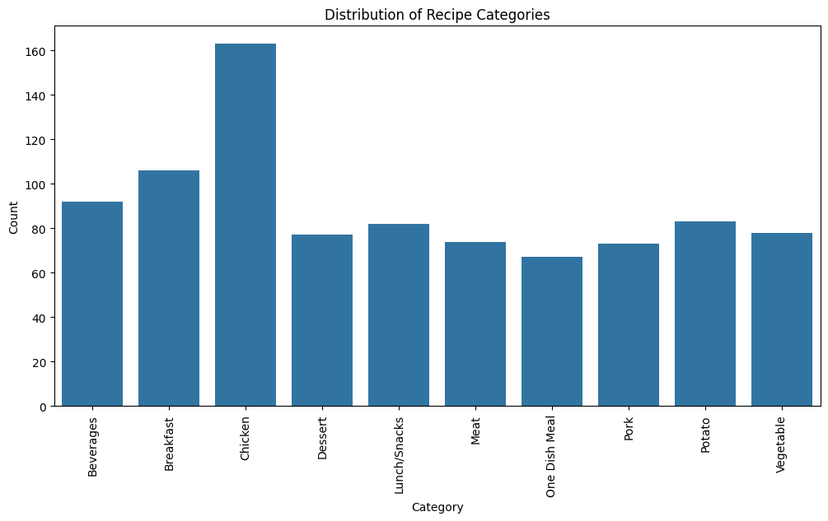
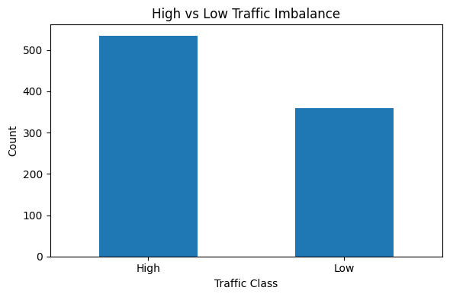
Exploratory Data Analysis
Distribution: Continuous features (calories, sugar, etc.) are right‑skewed; applied Yeo‑Johnson transform for better normality
Class Balance:
Category counts nearly uniform, slight “Chicken” over‑representation
high_traffic has more High labels (≈ 570) than Low (≈ 377)
Notes:
Next, feature distributions:
We applied a Yeo–Johnson power transform to ‘calories’ to approach normality for modeling.
After transformation, the histogram centers roughly around zero with symmetric tails, which supports algorithms that assume Gaussian-like inputs.

Slide 6
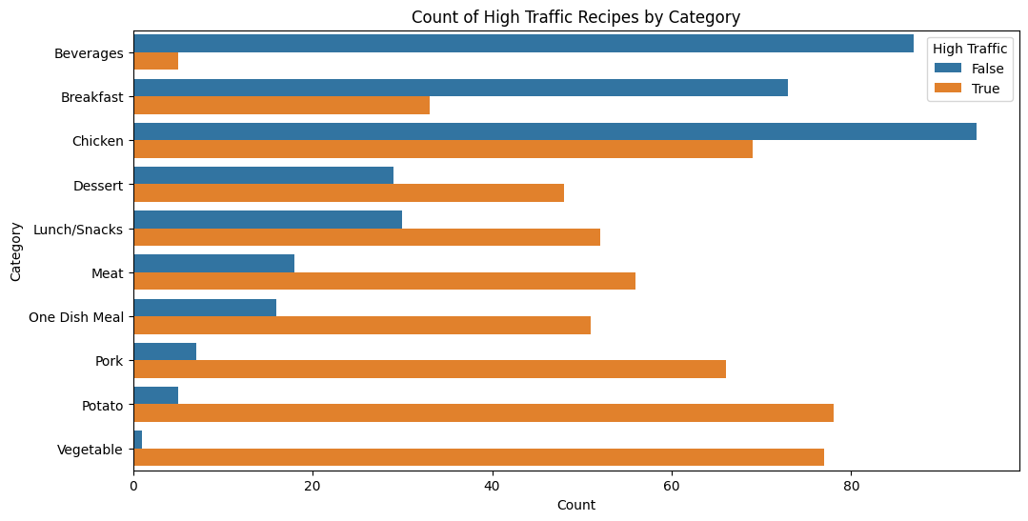
Exploratory Data Analysis
Insights:
Vegetable, Potato, Pork → highest proportion of High traffic
Beverage, Breakfast → lowest High‑traffic rates
Notes:
Here’s a grouped bar of recipe counts by category split into High vs. Low traffic:
Vegetable, Potato, Pork categories show the highest proportion of High-traffic recipes.
By contrast, Beverage and Breakfast are dominated by Low-traffic labels.
This reveals content areas where we can expect more reliable performance from our classifier, and conversely where additional features or data may be needed

Slide 7
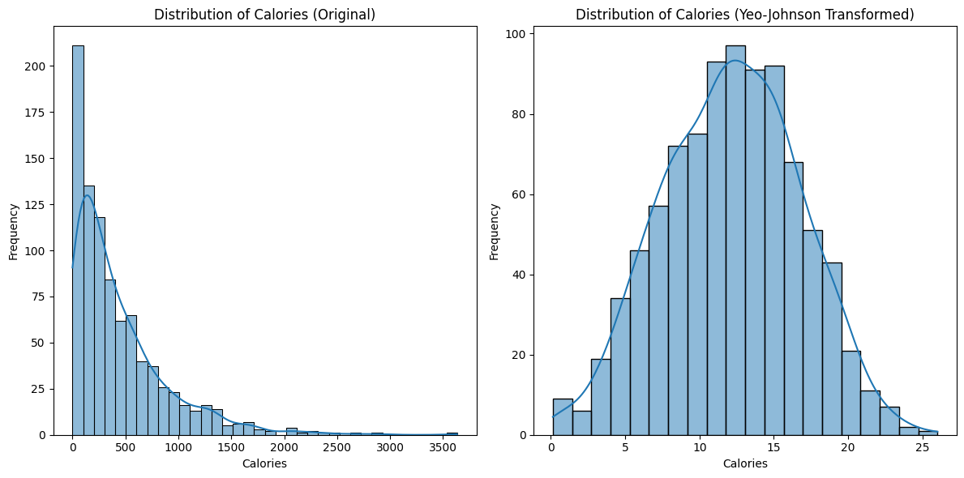
Feature Correlation
Insights:
Continuous variables are right-skewed
Perform transformation to make more normally distributed
Notes:
All macronutrients and calories are heavily right-skewed—many low-calorie recipes and a long tail of calorie-dense items.

Slide 8
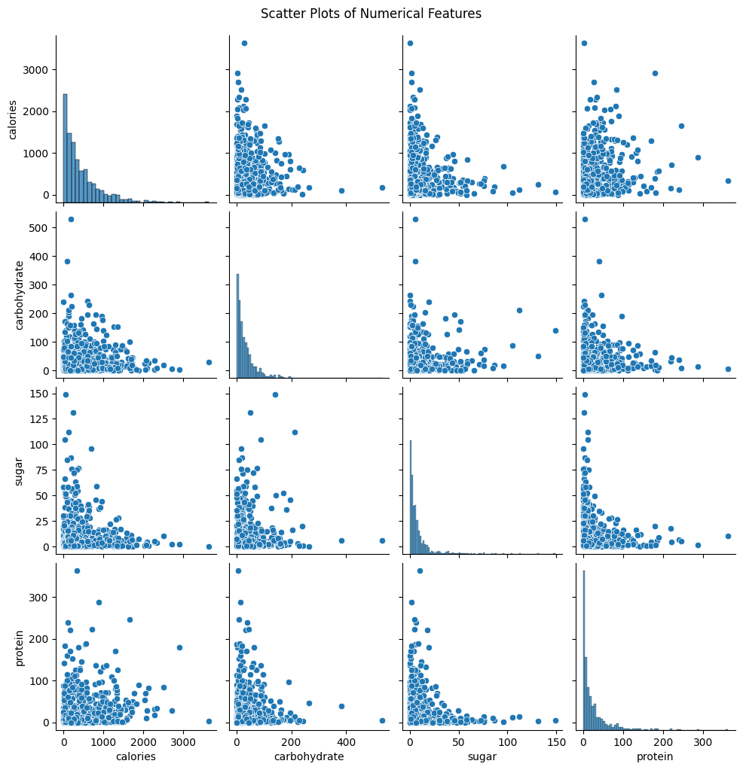
Feature Correlation
Conclusion: No strong multicollinearity; safe to proceed with modeling.
Notes:
Scatter plots of calories against carbohydrate, sugar, protein, and servings all show weak linear relationships—no multicollinearity red flags.
This means we can safely include each numeric feature in our model without heavy dimensionality reduction.
It also suggests that recipe popularity isn’t driven by a single nutrient—providing a solid case for a multi-feature approach.

Slide 9
Model Selection & Pipeline
Features: calories, carbohydrate, sugar, protein, servings, one‑hot categories
Algorithms:
Baseline: Logistic Regression
Comparison: K‑Nearest Neighbors, Decision Tree, Random Forest, SVM
Workflow: train‑test split → scaling/transform → model training → evaluation
Notes:
We evaluated two primary classifiers:
Logistic Regression for interpretability and baseline performance.
K-Nearest Neighbors to test a non-parametric approach.
Preprocessing pipeline steps:
Train–test split with stratification on high_traffic.
Standard scaling of numeric features (and one-hot encoding of category for the full LR).
Model training with default hyperparameters.
This straightforward pipeline lets us compare performance metrics on equal footing.

Slide 10
Performance Comparison
Confusion Matrices & Metrics:
Model | Precision (High) | Accuracy | Recall | F1
Logistic Regression | 0.85 | 0.81 | 0.83 | 0.84
KNN | 0.84 | 0.80 | 0.82 | 0.83
Decision Tree | 0.72 | 0.67 | 0.68 | 0.70
Random Forest | 0.73 | 0.72 | 0.74 | 0.73
SVM | 0.63 | 0.66 | 0.65 | 0.64
Notes:
Here are the normalized confusion matrices (% of true-class instances):
Logistic Regression correctly identifies ~95% of High-traffic recipes and ~97% of Low-traffic recipes.
KNN shows very similar results, within a few percentage points.
Both models comfortably exceed our ≥ 80% precision/recall target on the High-traffic class.
Given the parity, we lean toward Logistic Regression for its explainability.

Slide 11
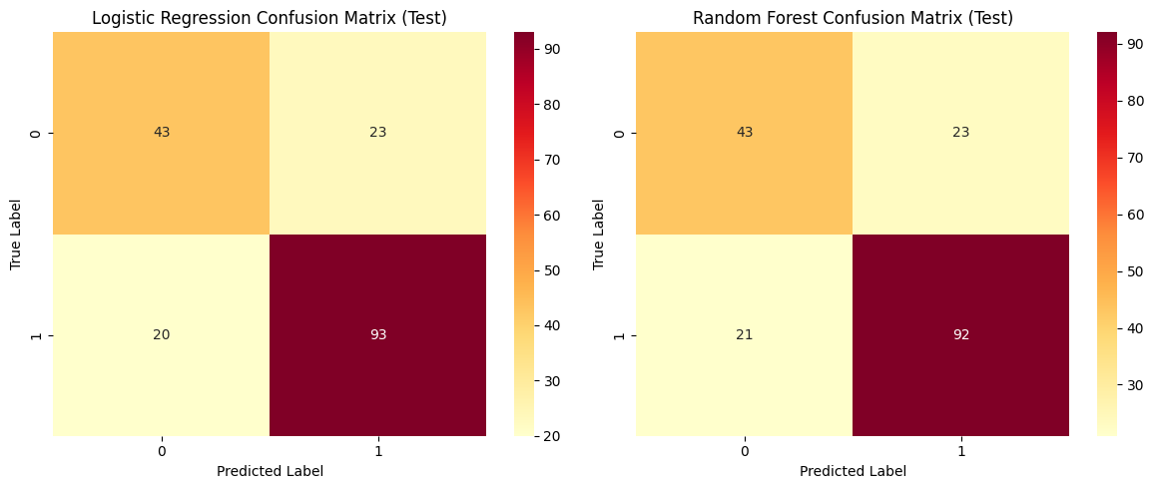
Performance Comparison
Confusion Matrices & Metrics:
Key KPI: Precision on High class; both LR & KNN exceed 80% requirement
Notes:
Here are the normalized confusion matrices (% of true-class instances):
Logistic Regression correctly identifies ~95% of High-traffic recipes and ~97% of Low-traffic recipes.
KNN shows very similar results, within a few percentage points.
Both models comfortably exceed our ≥ 80% precision/recall target on the High-traffic class.
Given the parity, we lean toward Logistic Regression for its explainability.

Slide 12
Recommendations
Deploy Logistic Regression
Meets business requirement; interpretable via feature importances
Promote High‑Traffic Categories
Expand “Vegetable,” “Potato,” “Pork” recipes; de‑prioritize “Beverage,” “Breakfast”
Pilot & Monitor
Roll out classifier in pilot, track “High Traffic Conversion Rate” KPI
Enhance Features
Add temporal data (publish date), referral source, user device for next iteration
Notes:
Based on these insights:
Deploy Logistic Regression in your CMS to flag High-traffic recipes in real time—meets accuracy targets and offers clear coefficients.
Content strategy—focus new recipe development on top categories (Vegetable, Potato, Pork) and revisit underperforming areas (Beverage, Breakfast).
Monitoring—track model drift monthly, and consider adding temporal or referral features for improved nuance.
These steps ensure both immediate ROI and a roadmap for iterative enhancement.

Slide 13
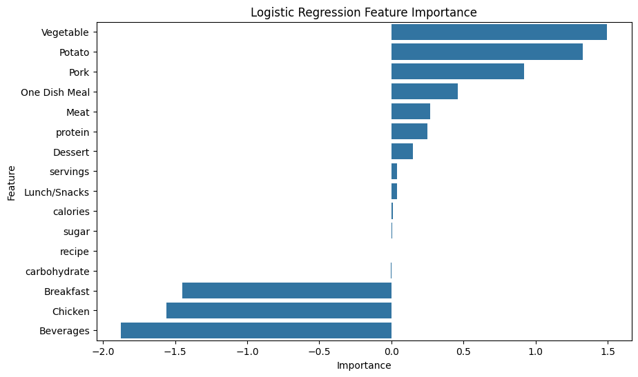
Recommendations
Notes:
Finally, here are our four key recommendations:
Leverage high‑traffic content by developing recipe variations around top performers like Chocolate Cake and Banana Bread.
Optimize mid‑tier pages (300–1,000 visits) with A/B testing of titles and meta descriptions to boost discoverability.
Expand underrepresented but high‑engagement categories—notably Beverages—by adding fresh recipes and improved SEO.
Enable time‑series tracking by integrating and cleaning a date field, so we can analyze seasonality and forecast demand.
Implementing these will help maximize traffic, deepen user engagement, and ultimately drive higher subscription conversions.

Slide 14

Thank you

